Slide 1
Session 4:
Proposal’s main parts
Quality and efficiency of the implementation
Proposal Writing Camp

Slide 2
Example: structure of a HORIZON EUROPE – CSA (Coordination and support action)
Part A (online form)
Administrative forms
Part B
(to be uploaded as pdf PDF)
Excellence
Impact
Quality and efficiency of implementation
->additional Annex with information on financial support to third parties (if applicable)

Slide 3
STRUCTURE OF THE PROPOSAL - PART B (CSA)B
1. Excellence
1.1 Objectives
1.2 Coordination and/or support measures and methodology
2. Impact
2.1 Project´s pathways to impact
2.2 Measures to maximise impact Dissemination
Exploitation and Communication
2.3 Summary
3. Quality and efficiency of the implementation
3.1 Work plan and Resources
3.2 Capacity of participants and consortium as a whole
PAGE LIMIT! 30 pages (CSA) – allways use the applicaiton from linked to the call (FTP)

Slide 4
B3. Quality and efficiency of the implementation
3.1 Work plan and Resources (14 pages including all tables / 19 pages for topics using lump sum funding)
3.2 Capacity of participants and consortium as a whole (3 pages)
Award criteria – aspects to be taken into account
Quality and effectiveness of the work plan, assessment of risks, and appropriateness of the effort assigned to work packages, and the resources overall
Capacity and role of each participant, and extent to which the consortium as a whole brings together the necessary expertise.

Slide 5
B3.1 Work plan and Resources
Content:
brief presentation of the overall structure of the work plan;
timing of the different work packages and their components (Gantt chart or similar);
graphical presentation of the components showing how they inter-relate (Pert chart or similar).
detailed work description, i.e.:
  a list of work packages (tables 3.1a);
  a description of each work package (table 3.1b);
  a list of deliverables (table 3.1c);

Slide 6
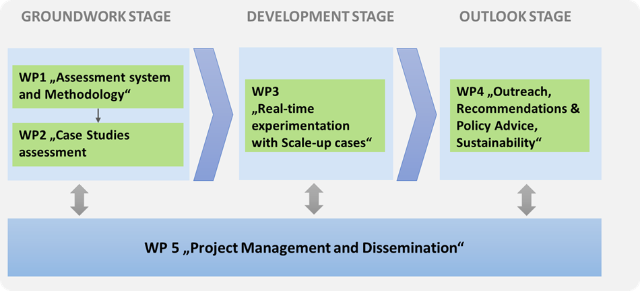
B3.1 Work plan and Resources
PERT chart - example:

Slide 7
B3.1 Work plan and Resources
GANTT chart - example:

Slide 8
Workpackage
IMPACTS (short, medium,long-term)
Tasks
Activities
Deliverables
Target GROUPS
Milestones
STAKEHOLDERS
KPI

Slide 9
B3.1 Work plan and Resources (2)
Content:
a list of milestones (table 3.1d);
a list of critical risks, relating to project implementation, that the stated project's objectives may not be achieved. Detail any risk mitigation measures. You will be able to update the list of critical risks and mitigation measures as the project progresses (table 3.1e);
a table showing number of person months required (table 3.1f);
a table showing description and justification of subcontracting costs for each participant (table 3.1g);
a table showing justifications for ‘purchase costs’ (table 3.1h) for participants where those costs exceed 15% of the personnel costs (according to the budget table in proposal part A);
if applicable, a table showing justifications for ‘other costs categories’ (table 3.1i);
if applicable, a table showing in-kind contributions from third parties (table 3.1j).

Slide 10
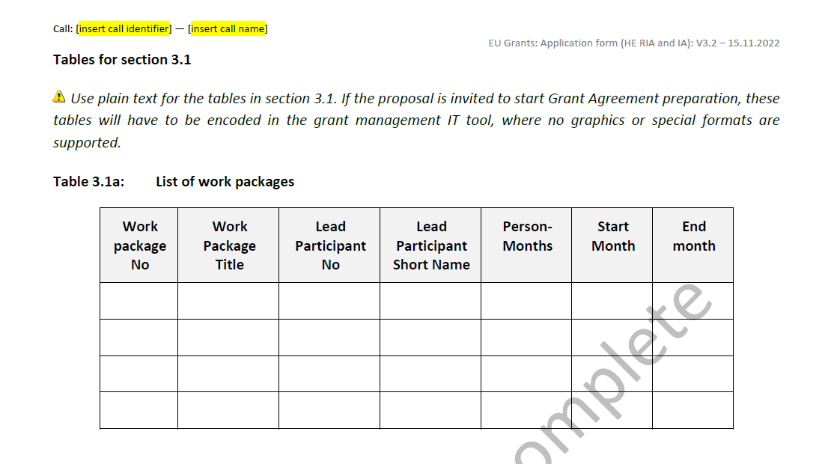
B3.1 Work plan and Resources (3)

Slide 11
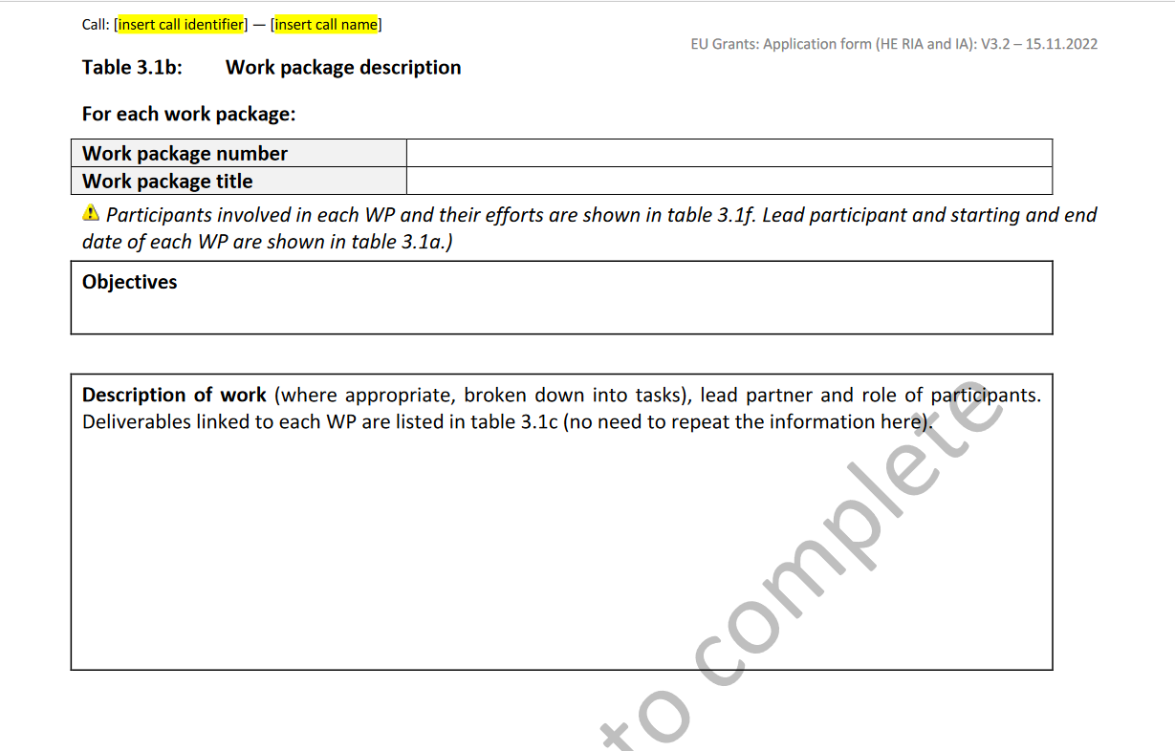
B3.1 Work plan and Resources (2)

Slide 12
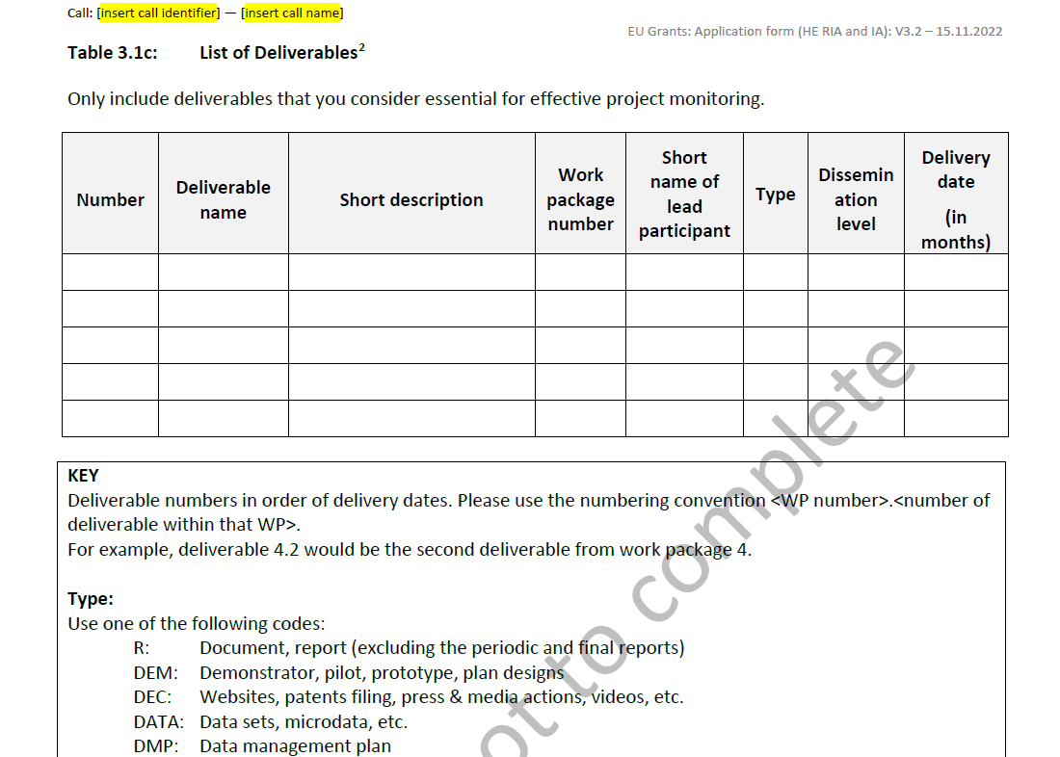
B3.1 Work plan and Resources (3)

Slide 13
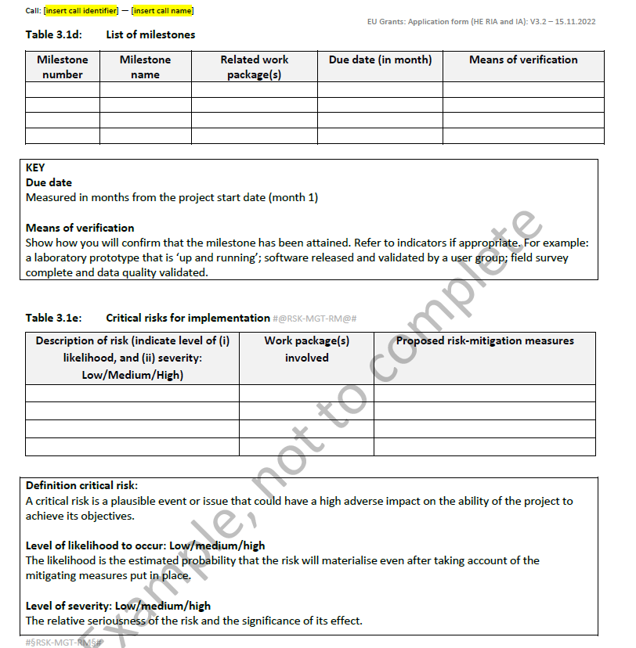
B3.1 Work plan and Resources (4)

Slide 14
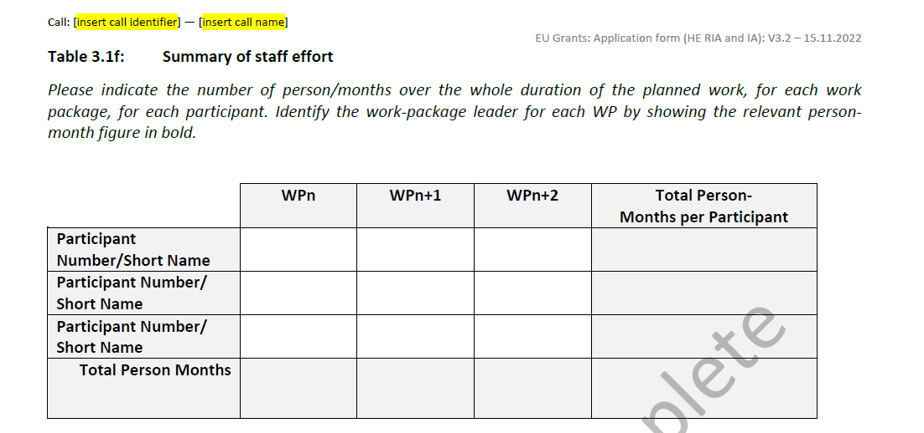
B3.1 Work plan and Resources (5)

Slide 15
B3.2 Capacity of participants and consortium as a whole
Describe the consortium. How does it match the project’s objectives, and bring together the necessary disciplinary and inter-disciplinary knowledge. Show how this includes expertise in social sciences and humanities, open science practices, and gender aspects of R&I, as appropriate. Include in the description affiliated entities and associated partners, if any.
Show how the partners will have access to critical infrastructure needed to carry out the project activities.
Describe how the members complement one another (and cover the value chain, where appropriate)
In what way does each of them contribute to the project? Show that each has a valid role, and adequate resources in the project to fulfil that role.

Slide 16
B3.2 Capacity of participants and consortium as a whole (2)
If applicable, describe the industrial/commercial involvement in the project to ensure exploitation of the results and explain why this is consistent with and will help to achieve the specific measures which are proposed for exploitation of the results of the project (see section 2.2).
Other countries and international organisations: If one or more of the participants requesting EU funding is based in a country or is an international organisation that is not automatically eligible for such funding (entities from Member States of the EU, from Associated Countries and from one of the countries in the exhaustive list included in the Work Programme General Annexes B are automatically eligible for EU funding), explain why the participation of the entity in question is essential to successfully carry out the project.

Slide 17
International cooperation in Horizon Europe Work Programme 2021-2022
Partner Search TOOLS
Use existing contacts with experience of EU funding programmes
Use Partner Search on the Funding and tenders portal: https://ec.europa.eu/info/funding-tenders/opportunities/portal/screen/how-to-participate/partner-search
Search the CORDIS database for participants in similar projects in FP7/H2020/HE: http://cordis.europa.eu/projects/home_en.html
Use social media (e.g. LinkedIn forums)
European NCP networks, National NCPs, COST actions…
https://ec.europa.eu/info/funding-tenders/opportunities/portal/screen/support/ncp
https://www.cost.eu/cost-actions-event/browse-actions/

Slide 18
GROUP WORK
Outline a structure of work-packages (WPs), related to the call you are interested in /or to the call discussed in the proposal writing camp. Prepare drafts of the work-packages.
Work in small groups
Establish the WP draft with
- WP number & title,
- objectives,
- contents / description of work (core part of WP), tasks
- partners,
- timing,
- deliverables.
Presentation of draft work-packages & analysis in the group
Follow the instructions from the application form

Slide 19

To do: PREPARE A WORKPLAN DESCRIPTION
(see template)

Slide 20
HOMEWORK
Continue elaborating the Work-Package (WP) draft/s until the next session on Wednesday.
Focus on refining WP drafts of
- objectives ,
- task descriptions: contents / description of work, broken down into several tasks (e.g. 4-5 per WP, depending on complexity of a project). This is the core part of a WP, and needs to be detailed.
- deliverables (e.g. specify one per task).
You may coordinate and do the work jointly with colleagues, who also participate in the Proposal writing Camp.
Send the drafts of your WP/task descriptions per e-mail on Tuesday afternoon before the next session to the trainers. Certain colleagues will be asked to present briefly the result at the feedback session (Wednesday morning).
Follow the instructions in the application form. See chapter 3 Quality and efficiency of the implementation as of page 32 standard application form:
https://ec.europa.eu/info/funding-tenders/opportunities/docs/2021-2027/horizon/temp-form/af/af_he-ria-ia_en.pdf

